Slide 1
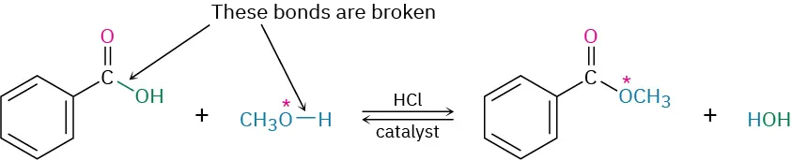
Reactor (T & P)
R1 (Equilibrium reactor): The flowsheet utilizes an equilibrium reactor for the esterification reaction. A near-complete conversion of Benzoic Acid has been observed in the equilibrium reactor, yielding a large k, which we will correct once we obtain the detailed kinetics.
Since it's Equilibrium Reactor, temperature & pressure are taken directly from the feed stream(s) entering in it, implying Temperature is 25 °C and Pressure is 1 bar.
Benzoic Acid + Methanol → Methyl Benzoate + H₂O

Slide 2
Operating Conditions for Reactor:
The Molar Ratio (Methanol : Benz_A = 16.59 : 2.7)
High Excess of Methanol: The Primary purpose is to drive equilibrium toward ester formation. This ratio enabled a large amount of water in the product. In our process, water helped in the energy-efficient separation of methanol.
Source: Roberts & Urey (1938)¹
Moderate Temperature (25°C)
Warm enough to maintain reasonable reaction rates Cool enough to prevent excessive side reactions. And at this temperature all except the acids are in liquid phase. The excess methanol well encompasses the requirement of solvent for Benzoic Acid (as per solubility data).
Near Atmospheric Pressure (1 bar)
The primary reason is that this pressure is cost-effective equipment-wise. Another important reason is that no azeotropes are formed at this pressure.

Slide 3
Distillation Column Design & Sequencing
Distillation Column Sequencing:

Slide 4
Distillation Column Design & Sequencing
Distillation Column Sequencing:
Methanol + Water
Methanol
Methyl Benzoate
Benzoic Acid
C1
C2
C3
C4
Methyl Benzoate + Benzoic Acid + Phthalic Acid
Water
Benzoic Acid + Phthalic Acid
Phthalic Acid

Slide 5
Distillation Column DESIGN & Sequencing
Distillation Column Design:
C1 | C2 | C3 | C4
For 99.9% water recovery: | For 99.99% methanol recovery & 99.9% water recovery: | For 99.7% Methyl Benzoate recovery: | For 99.9% Benzoic Acid recovery:
No of Trays: 20 Feed Stage: 11 Reflux Ratio: 0.018697 Reboiler Duty: 22531.7 kW Condenser Duty: -17596.4 kW | No of Trays: 20 Feed Stage: 14 Reflux Ratio: 1.7256 Reboiler Duty: 38339.7 kW Condenser Duty: -38109 kW | No of Trays: 20 Feed Stage: 11 Reflux Ratio: 0.3033 Reboiler Duty: 4291.45 kW Condenser Duty: -4435.88 kW | No of Trays: 20 Feed Stage: 10 Reflux Ratio: 1.19132 Reboiler Duty: 25 kW Condenser Duty: -18.84 kW

Slide 6

Distillation Column Design & Sequencing: VLE checks
Column 2 Distillate:
Methanol = 0.9998
Water = 0.0002
Temp = 64.2 °C
Tsat = 64.26 °C

Slide 7
Distillation Column Design & Sequencing: VLE checks
Column 2 Bottom:
Methanol = 0.001
Water = 0.999
Temp = 104.34 °C
Tsat = 104.44 °C

Slide 8
Distillation Column Design & Sequencing: VLE checks
Column 3 Distillate:
MEB = 0.99
Water = 0.01
Temp = 190 °C
Tsat = 191.32°C

Slide 9
Distillation Column Design & Sequencing: VLE checks
Column 3 Bottom:
PTH = 0.6
MEB = 0.4
Temp = 247 °C
Tsat = 247.24°C

Slide 10
Operating Conditions for Distillation Columns
Column | Condensor Pressure | Condensor Temperature | Reboiler Pressure | Reboiler Temperature
C1 | 1 bar | 66.6 °C | 1.2 bar | 198.1 °C
C2 | 1 bar | 64.2 °C | 1.2 bar | 104.4 °C
C3 | 1 bar | 190.8 °C | 1.2 bar | 247.1 °C
C4 | 1 bar | 200.11 °C | 1.2 bar | 331.45 °C

Slide 11
Design Specifications
Column 1
Methanol + Water
Design Specification | Component | Value
Mole Recovery | Water (D1) | 0.99
Vary | Limit (kW) | Value (kW)
Reboiler Duty | 0.01-10⁷ | 22531.659
Methyl Benzoate + Benzoic Acid + Phthalic Acid

Slide 12
Design Specifications
Column 2
Methanol
Design Specification | Component | Value
Mole Recovery | Methanol (D2) | 0.9998
Mole Recovery | Water (B2) | 0.999
Vary | Limit | Value
Reflux Ratio | 0.01-100 | 1.726
Reboiler Duty | 0.01-10⁶ (kW) | 38339.74 (kW)
Water

Slide 13
Design Specifications
Column 3
Methyl Benzoate
Design Specification | Component | Value
Mole Recovery | MEB (D3) | 0.9975
Vary | Limit | Value
Reflux Ratio | 0.0001-100 | 0.30334847
Benzoic Acid + Phthalic Acid

Slide 14
Design Specifications
Column 4
Benzoic Acid
Design Specification | Component | Value
Mole Recovery | Phthalic Acid (B4) | 0.999
Vary | Limit | Value
Reflux Ratio | 0.001-100 | 1.19131864
Phthalic Acid

Slide 15
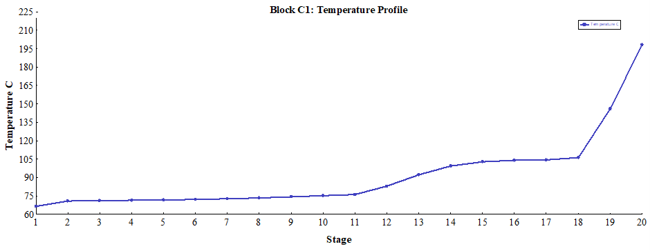
Temperature Profiles for Distillation Columns

Slide 16
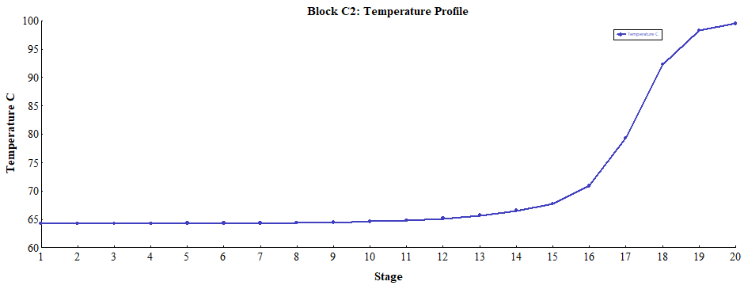
Temperature Profiles for Distillation Columns

Slide 17
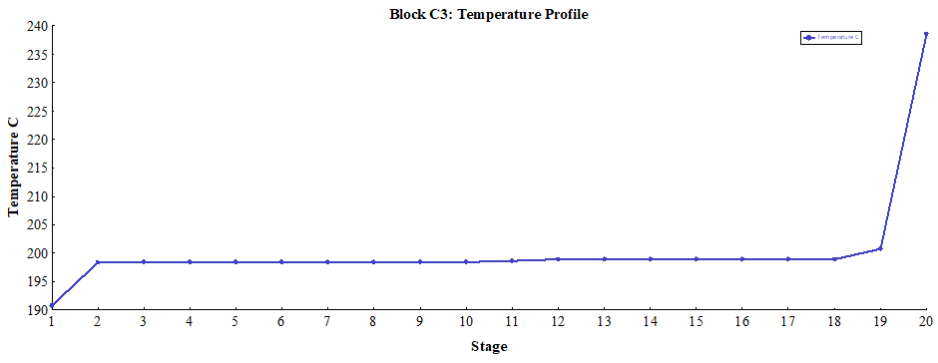
Temperature Profiles for Distillation Columns

Slide 18
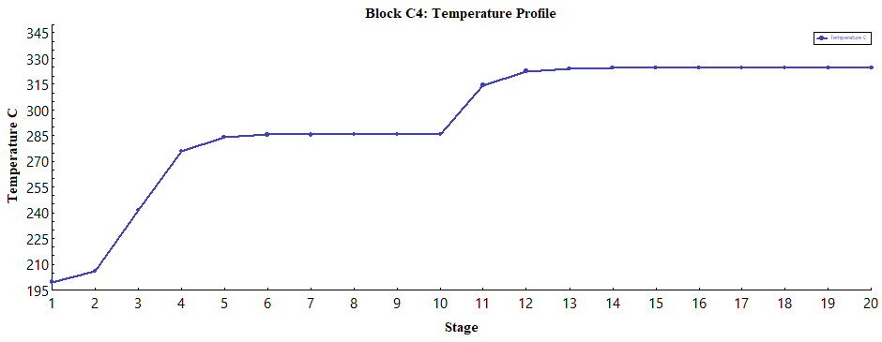
Temperature Profiles for Distillation Columns

Slide 19
ChE 453: Capstone Project
Mid Semester Presentation
Group 4

Slide 20
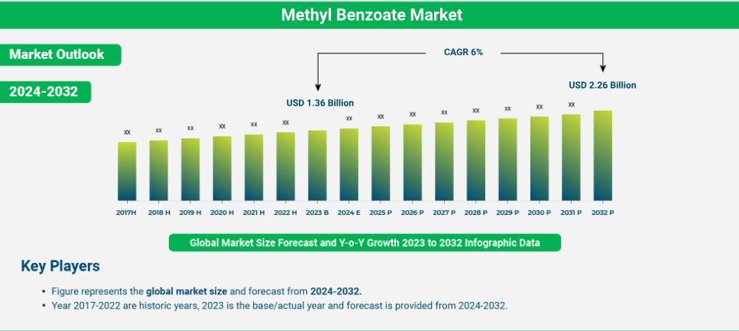

Rationale for choice of product (Methyl Benzoate)
Methyl Benzoate selected due to high demand in fragrance, flavor, and pharmaceutical industries.​
Exhibits 6% CAGR growth (2024–2032), market projected to reach USD 2,260 million by 2032.​
Multi-purpose applications: solvent, agrochemicals, intermediates, and antifungal uses.​
High value product compared to raw feedstocks (Methanol & Benzoic Acid).​
https://dataintelo.com/report/global-methyl-benzoate-market

Slide 21
Product Purity Considerations
Target: High-purity methyl benzoate to meet industrial-grade standards (~99%).
Impurities: Trace phthalic acid (in Benzoic Acid)
UNIQUAC thermodynamic model ensures accurate phase behavior and separation efficiency.
No azeotrope formation → simplifies purification & lowers separation costs.

Slide 22
Feedstock Quality
Methanol: 16.95 moles, low cost (USD 345–370/MT), widely available.
Benzoic Acid: 2.7 moles with 0.5% phthalic acid impurity; quality feed ensures reaction efficiency.
Stable global supply: both feedstocks projected for steady market growth (Methanol CAGR 4.7%, Benzoic Acid CAGR 5.3%).
Selection balances cost efficiency with required chemical reactivity.
Molar Ratio of Methanol to Benzoic Acid is taken as 6.27 for optimum utility. Source: Roberts & Urey (1938)¹

Slide 23
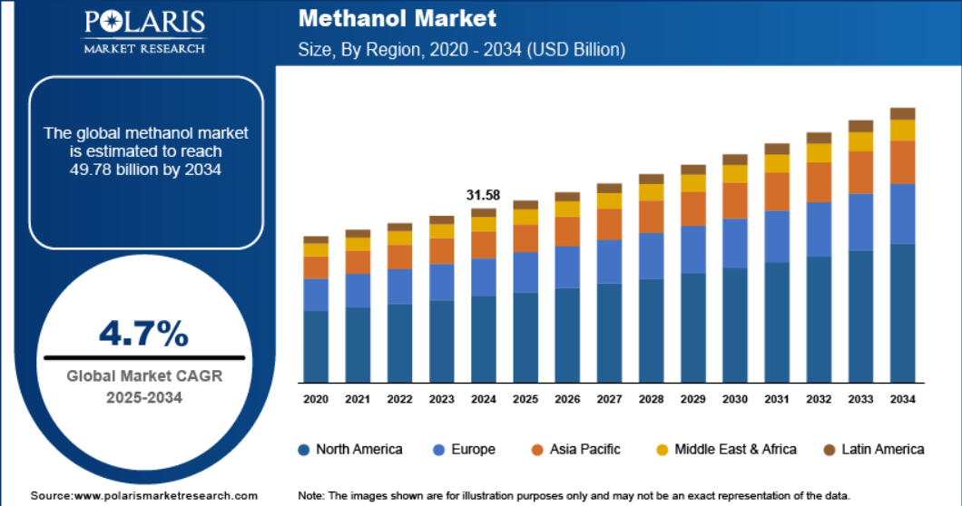
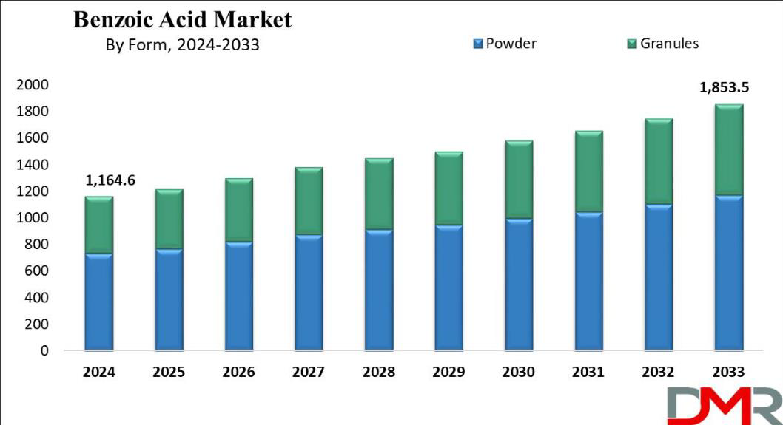
Feedstock Quality
Methanol Market: CAGR (4.7%, 2025-2034)
Benzoic Acid Market: CAGR (5.3%, 2024-2033)
https://www.polarismarketresearch.com/industry-analysis/methanol-market
https://dimensionmarketresearch.com/report/benzoic-acid-market

Slide 24
Input-Output Economic Feasibility
 | Benzoic Acid | Methanol | Methyl Benzoate
 |  |  |  | Molar Efficiency
MW(gm/mole) | 122.12 | 32.04 | 136.15 | 0.9
Mass(kg) | 996.61 | 1641.02
Raw Mass(kg) | 1001.62 | 1641.02 | 1000.00 | Methanol Purity
Mole/day | 8160.91 | 51217.79 | 7344.82 | 1
Excess Mole | 0.00 | 43056.88
Raw Mass(MTon) | 1.00161809 | 1.641018026 | 1.00 | Benzoic Acid Purity
Cost(USD/MT) | 1010.00 | 370.00 | 2200.00 | 0.995
UnReacted Mole | 816.09 | 43872.97
UnReacted Mass(Mton) | 0.10 | 1.41 |  | MeOH:BnZ_A
Total Cost(USD) | 1011.634271 | 607.1766696 | 2199.99 | 1.6466
Total Input Cost (USD) |  |  | 1618.81
Excess Reactant Cost (USD) |  |  | 620.76
Total Output Cost (USD) |  |  | 2199.99
Net Profit (USD) |  |  | 1201.94
Profit (x) |  |  | 1.204295709
Source: Roberts & Urey (1938)¹

Slide 25
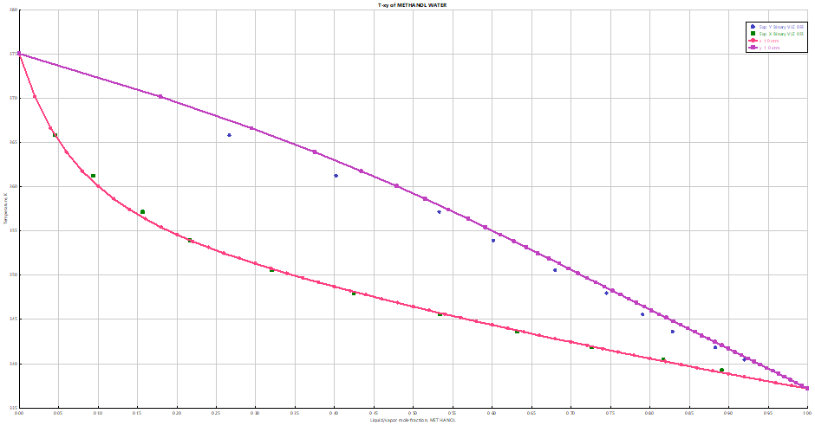
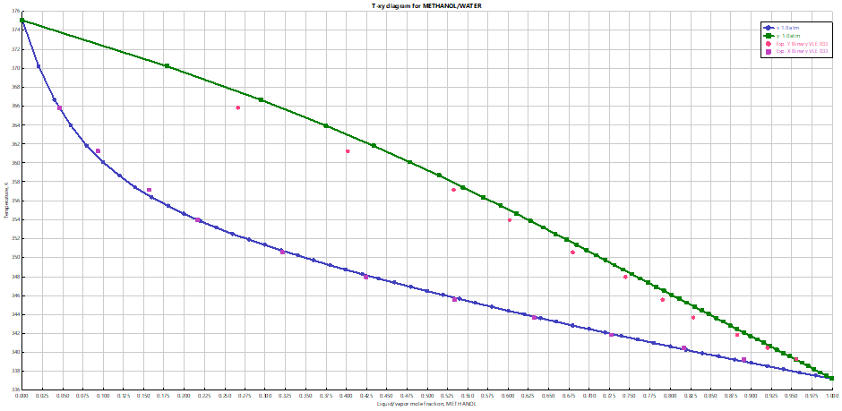
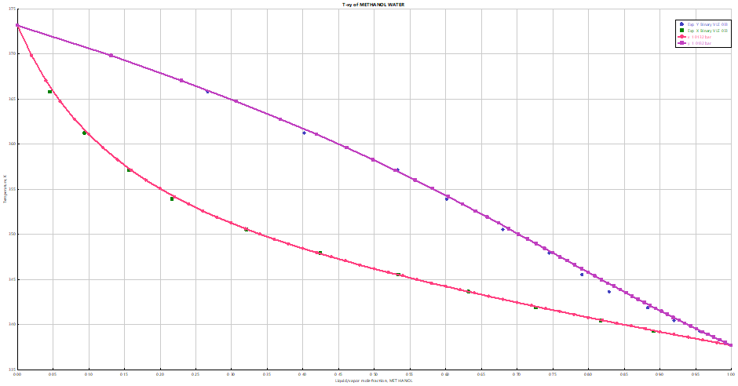
Thermodynamic model validation
NRTL
PENG-ROB
UNIQUAC IS THE BEST MODEL, AS IT BEST FITS THE DATA!
UNIQUAC

Slide 26
Thermodynamic Parameters
Estimated the rest of parameters of UNIQUAC model using UNIFAC
Component _{i} | Component _{j} | A_{IJ} | A_{JI} | B_{IJ} | B_{JI} | C_{IJ} | C_{JI} | D_{IJ} | D_{JI} | T_{lower} (C) | T_{upper} (C)
BENZA | WATER | -61.6506 | -7.3661 | 2424.886 | 1073.019 | 9.4538 | 0.4699 | 0 | 0 | 64 | 115.5
BENZA | METH | 0 | 0 | -19.163 | 210.75 | 0 | 0 | 0 | 0 | 20 | 40
WATER | METH | 0.6437 | -1.0662 | -322.131 | 432.8785 | 0 | 0 | 0 | 0 | 24.99 | 100
MEB | BENZA | 0 | 0 | -249.979 | 151.4731 | 0 | 0 | 0 | 0 | 25 | 25
MEB | WATER | 0 | 0 | -421.25 | -165.418 | 0 | 0 | 0 | 0 | 25 | 25
MEB | METH | 0 | 0 | -385.159 | 48.13078 | 0 | 0 | 0 | 0 | 25 | 25
MEB | PTH | 0 | 0 | -297.173 | 128.2428 | 0 | 0 | 0 | 0 | 25 | 25
BENZA | PTH | 0 | 0 | -36.1404 | 19.82719 | 0 | 0 | 0 | 0 | 25 | 25
WATER | PTH | 0 | 0 | -261.525 | 104.1981 | 0 | 0 | 0 | 0 | 25 | 25
METH | PTH | 0 | 0 | 188.7415 | -303.671 | 0 | 0 | 0 | 0 | 25 | 25

Slide 27
Section 2
Block diagram and rationale behind the process synthesis (covering elements like feed purification, product separation, recycles etc.)
Material balance

Slide 28
Block diagram

Slide 29
Block diagram
Fresh Benzoic Acid Feed: Solid reactant input (2.7 mol ratio); provides core material for esterification, directly fed to the mixer M1 for slurry creation.
Fresh Methanol Feed: Excess reactant (16.59 mol ratio); acts as solvent and equilibrium shifter, can be recycled to sustain high conversion and reduce costs.
B5 Heater: Preheats feed stream to maintain desired reaction temperature i.e., 298.15 K.
M1 Mixer: Blends benzoic acid and methanol into slurry; handles solid dissolution for phase-compatible reactor feed, ensures efficient reaction start.
Mass flows of reactants taken initially :-
Methanol: 54303 kg/hr, Benzoic acid: 32851 kg/hr
Mass of products formed:-
Methyl benzoate: 36529 kg/hr, Water: 48.5 kg/hr
*The above have been taken based on ratios provided in the original literature, as well as enabling a significant profit margin. Also, we have kept ease of verification in mind

Slide 30
Block diagram
R1 Equilibrium Reactor: Site of esterification (Benzoic Acid + Methanol → Methyl Benzoate + H₂O); models' reversible kinetics with such excess ratio yields very large k indicating near-complete conversion.
C1 Distillation Column: Initial split of R1 effluent to D1 (methanol/water overhead) and B1 (MEB/acids bottoms); 20 trays, low reflux for energy-efficient light removal based on volatility differences.

Slide 31
Block diagram
C2 Distillation Column: Purifies D1 into D2 (methanol distillate, 99.99% recovery) and B2 (water bottoms); 20 trays.

Slide 32
Block diagram
C3 Distillation Column: Isolates D3 (MEB distillate, 99.7% recovery) from B3 (acids bottoms); 20 trays exploit MEB volatility for product purification with minimal energy (low reflux).

Slide 33
Block diagram
C4 Distillation Column: Recovers D4 (benzoic acid distillate, 99.9%) from B4 (phthalic acid purge bottoms); 20 trays close acid loop, removes impurities to prevent buildup.

Slide 34
Material & Energy Balance
Material and Energy Balance for Columns 1 and 2
Column C1 | Mass In (S1) | Mass Out(B1) | Mass Out(D1) | Mass Out total
Methyl Benzoate | 36622.21057 | 36620.80996 | 1.400610149 | 36622.21057
Benzoic Acid | 1.996230958 | 1.996230958 | 2.47E-24 | 2.00E+00
Water | 4845.815842 | 48.45815348 | 4797.357689 | 4845.815842
Methanol | 45692.64392 | 0.017089908 | 45692.62683 | 45692.64392
Phthalic Acid | 166.13324 | 166.13324 | 1.97E-39 | 1.66E+02
TOTAL | 87328.7998 |  |  | 87328.7998
Column C1 | Heat In (kW) |  | Heat out (kW)
Feed (S1) | -141828.2926 | Distillate C1 (D1) | -113817.4079
Reboiler Duty C1 (Qr) | 22532 | Bottoms C1 (B1) | -23075.58014
Condenser Duty C1 (Qc) | -17596
Total | -136892.2926 | Total | -136892.988
Column C2 | Mass In (D1) | Mass Out(B2) | Mass Out(D2) | Mass Out total
Methyl Benzoate | 1.400610149 | 1.400610149 | 0 | 1.400610149
Benzoic Acid | 2.47E-24 | 0 | 0 | 0
Water | 4797.357689 | 4792.560331 | 4.797357688 | 4797.357689
Methanol | 45692.62683 | 9.138525366 | 45683.4883 | 45692.62683
Phthalic Acid | 1.97E-39 | 0 | 0 | 0
TOTAL | 50491.38513 |  |  | 50491.38513
Column C2 | Heat In (kW) |  | Heat out (kW)
Distillate C1 (D1) | -113817.4079 | Distillate C2 (D2) | -92874.60482
Reboiler Duty C2 (Qr) | 38340 | Bottoms C2 (B2) | -20712.05695
Condenser Duty C2 (Qc) | -38109
Total | -113586.4079 | Total | -113586.6618

Slide 35
Material & Energy Balance
Material and Energy Balance for Columns 3 and 4
Column C3 | Mass In (B1) | Mass Out(B3) | Mass Out(D3) | Mass Out total
Methyl Benzoate | 36620.80996 | 91.55202489 | 36529.2579 | 36620.80992
Benzoic Acid | 1.996230958 | 1.967318305 | 0.028912653 | 1.996230958
Water | 48.45815348 | 3.84E-15 | 48.45815344 | 4.85E+01
Methanol | 0.017089908 | 9.13E-18 | 0.017089908 | 1.71E-02
Phthalic Acid | 166.13324 | 166.13324 | 1.48E-12 | 1.66E+02
TOTAL | 36837.41467 |  |  | 36837.41464
Column C3 | Heat In (kW) |  | Heat out (kW)
Bottoms C1 (B1) | -23075.58014 | Distillate C3 (D3) | -22966.23687
Reboiler Duty C3 (Qr) | 4291 | Bottoms C3 (B3) | -253.7746107
Condenser Duty C3 (Qc) | -4436
Total | -23220.58014 | Total | -23220.01149
Column C4 | Mass In (B3) | Mass Out(B4) | Mass Out(D4) | Mass Out total
Methyl Benzoate | 91.55202489 | 7.38E-07 | 91.55202415 | 9.16E+01
Benzoic Acid | 1.967318305 | 1.97E-05 | 1.967298588 | 1.97E+00
Water | 3.84E-15 | 0 | 0 | 0
Methanol | 9.13E-18 | 0 | 0 | 0
Phthalic Acid | 166.13324 | 165.9671068 | 0.16613324 | 166.13324
TOTAL | 259.6525832 |  |  | 259.6525832
Column C4 | Heat In (kW) |  | Heat out (kW)
Bottoms C3 (B3) | -253.7746107 | Distillate C4 (D4) | -58.29793905
Reboiler Duty C4 (Qr) | 25 | Bottoms C4 (B4) | -189.3194072
Condenser Duty C4 (Qc) | -19
Total | -247.7746107 | Total | -247.6173463

Slide 36
Block Diagram at a Glance

Slide 37
Cogeneration Unit & Turbines Operating conditions
40 bar
HX1
3 bar
1 bar
10 bar
HX1 Heat Exchanger: Preheats the incoming Rankine feed using water from C2 bottoms, reducing preheater duty

Slide 38
Distillation Column Energy Requirements
Column | Condensor Pressure | Condensor Temperature | Reboiler Pressure | Reboiler Temperature
C1 | 1 bar | 66.6 °C | 1.2 bar | 198.1 °C
C2 | 1 bar | 64.2 °C | 1.2 bar | 104.4 °C
C3 | 1 bar | 190.8 °C | 1.2 bar | 247.1 °C
C4 | 1 bar | 200.11 °C | 1.2 bar | 331.45 °C
CW Req | Energy | HPS Req | Energy | LPS Req | Energy
C1 Condenser | 120098. kW | C1 Reboiler | 120791 kW
C2 Condenser | 202084. kW |  |  | C2 Reboiler | 202132 kW
C3 Condenser | 4341 KW | C3 Reboiler | 4291 kW
C4 Condenser | 999 kW | C4 Reboiler | 1000 kW
Net | 327522 kW | Net | 126082 kW | Net | 202132 kW

Slide 39
Cogeneration Analysis: Requirement, Production, Deficit
Distillation Unit Requirement
CW Loop Requirement
CW Req | Energy | HPS Req | Energy | LPS Req | Energy
C1 Condenser | 120098. kW | C1 Reboiler | 120791 kW
C2 Condenser | 202084. kW |  |  | C2 Reboiler | 202132 kW
C3 Condenser | 4341 KW | C3 Reboiler | 4291 kW
C4 Condenser | 999 kW | C4 Reboiler | 1000 kW
Net | 327522 kW | Net | 126082 kW | Net | 202132 kW
CW Req | Energy
HEN4 | 772 KW
HEN5 | 16 KW
Rest | 331536 kW
Overall Requirements
Utility Requirements
Unit | Net Requirements Cooling Water (kW)
Distillation | 327522
CW | 332324
Unit | Net Requirements High Pressure Steam (kW)
Distillation | 126082
Unit | Net Requirements Low Pressure Steam (kW)
Distillation | 202132
Stream | Energy Required | Mass Flow
HPSOUT | 126083 kW | 206574 kg/hr
LPSOUT | 205976 kW | 330828 kg/hr
Cooling Water | 332324 kW | 11441600 kg/hr
*We have assumed that steam cannot be cooled beyond 100°C and cooling water cannot be heated beyond 40°C

Slide 40
Cogeneration Analysis: Net Electricity Generation
Stream | Electricity Produced (kW)
ELEC1 | 5.98 x 10⁹
ELEC2 | 1.70 x 10¹⁰
ELEC3 | 1.14 x 10¹⁰
ELEC4 | 8.21 x 10⁹
TOTAL | 4.26 x 10¹⁰
Mass flows of reactants taken initially :-
Methanol: 6964.89 kg/hr, Benzoic acid: 12016.40 kg/hr
Mass of products formed:-
Methyl benzoate: 13396.4 kg/hr
Total mass flow of water required in Rankine Cycle:-
Water: 1.62 x 10¹¹ kg/hr (Hot Utility)
Total flow of Cooling Water required:-
Water:1.44 x 10⁷ kg/hr (Cold Utility)
Methanol : Benzoic Acid : Methyl Benzoate : Hot Stream Utility : Cold Stream Utility
1 : 1.73 : 1.92 : 2.33 x 10⁷ : 2.067 x 10³

Slide 41
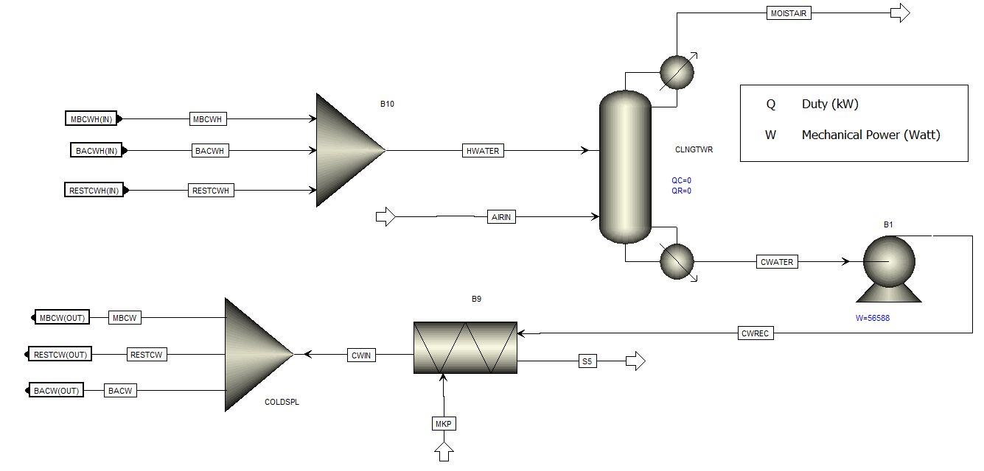
Cooling water loop
Notes:
MBCWH AND MBCW cooling inlet and hot outlet water from cooling methyl benzoate
BACWH AND BACW cooling inlet and hot outlet water from cooling benzoic acid

Slide 42

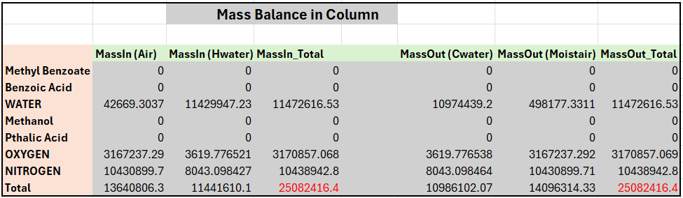
Cooling water loop
Notes:
MBCWH AND MBCW cooling inlet and hot outlet water from cooling methyl benzoate
BACWH AND BACW cooling inlet and hot outlet water from cooling benzoic acid

Slide 43
Cooling water loop
Design Spec | Manipulated variable | Target variable | Target value
1. | BACW Flow Fraction | BACWH Temperature | 40 °C
2. | MBCW Flow Fraction | MBCWH Temperature | 40 °C
3. | Total Mass Flow across MAKEUP | Total Fresh Cooling Water required | 0 tonne/hr

Slide 44
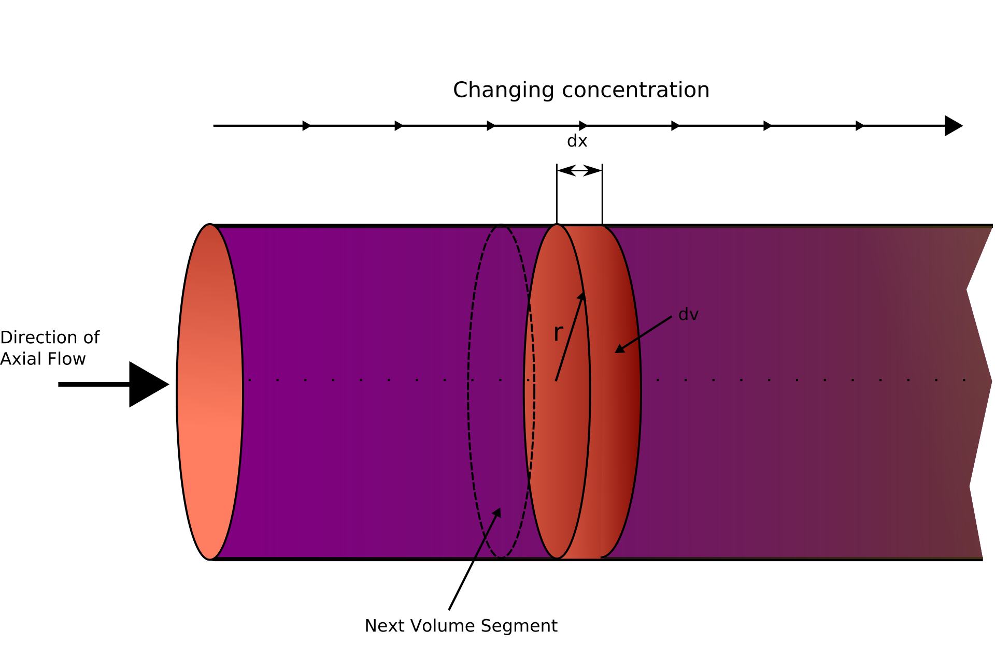
Reactor design and sequencing with detailed kinetics:
We are using a Plug Flow Reactor in our process with a conversion of 99.628%. Although the reaction is reversible, due to a lack of data (The value k in backward reaction was not provided and Keq calculation was not possible, as affirmed in the paper), we are considering our reaction only in the forward direction.

Slide 45
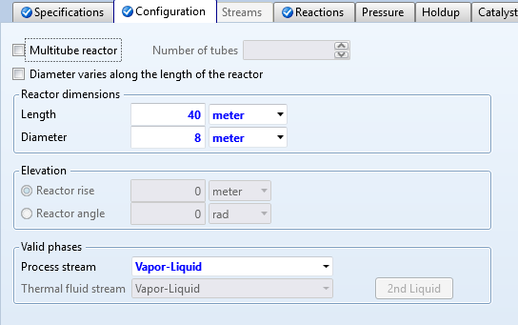
Reactor Design:
Flow Regime:
Average Velocity: 0.004328 m/s
Reynolds Number: 36960.81
Flow Regime: Turbulent (Re ≥ 4000)
The flow regime obtained in our reactor is turbulent which is consistent with standard industrial practices.
We usually operate PFR in turbulent regime due to following reasons:
Complete radial mixing (uniform temperature/concentration)
High heat transfer coefficients
Minimized axial dispersion (plug-flow approach)

Slide 46
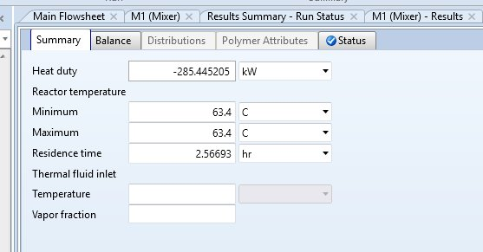
Reactor Design:
Residence time:
The residence time obtained in our reactor is 2.56 hours, which is consistent with typical industrial ranges (1–5 hours) for plug flow reactors, especially for reactions requiring extended contact time.
In our system, we obtained a single-pass conversion of 58%. We implement reactant recycling to optimize resource utilization and minimize waste, allowing unreacted species to re-enter the reactor. This significantly boosts the overall conversion to 99.93%.

Slide 47
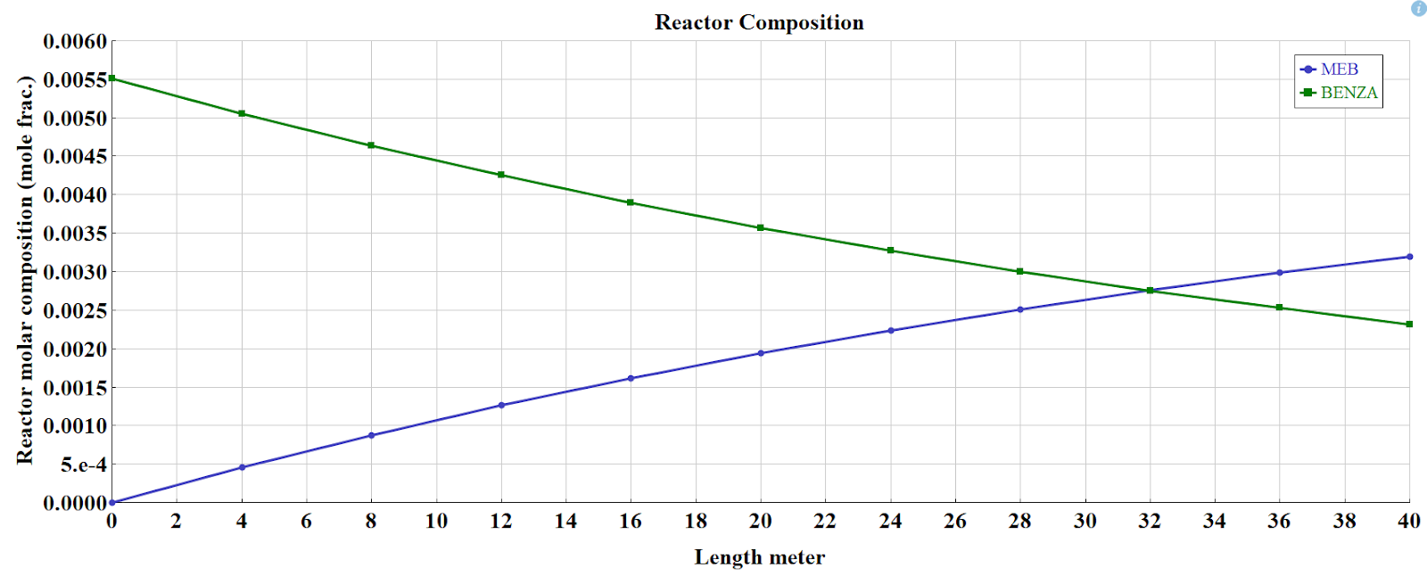
Results:
Composition Profile of Reactor:
Fresh methanol feed rate = 61.3666 kmol/hr
Fresh benzoic acid feed rate = 57.812 kmol/hr Methyl Benzoate outlet flow rate = 57.77 kmol/hr
Conclusion:
BENZA is the reactant, and it is being consumed along the reactor length.
MEB is the product, and it is being formed progressively as the reaction proceeds.
The monotonic decrease in BENZA and increase in MEB confirms that the reaction is proceeding forward without significant reverse reaction.

Slide 48
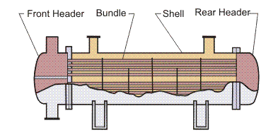
DETAILED HEAT EXCHANGER:
The Tubular Exchanger Manufacturers Association (TEMA) is an association of manufacturers of shell and tube heat exchangers. TEMA has established a set of construction standards for Shell and Tube Heat Exchangers.
E-Type shell is the more commonly used shell type, suitable for most duties and applications.
Tube diameter layout and pitch:
Tubes may range in diameter from 12.7 mm (0.5 in) to 50.8 mm (2 in), but 19.05 mm (0.75 in) and 25.4 mm (1 in) are the most common sizes.
Notes:
"Good morning. I'll be presenting the detailed design of our *Shell and Tube Heat Exchanger*. The fundamental conceptual theory at play here is *convective heat transfer*
. We use this Shell and Tube Heat Exchanger to separate the hot and cold fluids, forcing heat to transfer efficiently across the metal tube walls. We chose the standard *TEMA E-Type shell* , which is the most common and cost-effective choice for general duties.

Slide 49
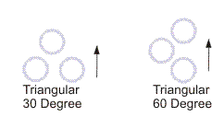
Shell & tube specification:
Tube Specifications:
Outer diameter: 20 mm
Inner diameter: 16 mm
Standard Length: 4.88 m
Area of tube (πDL) = 0.303324 m²
Number of tubes: 2425
Tin = 64.2 ℃, Tout = 35 ℃
Tmean = 49.6 ℃
Single pass
Mass Flow rate(kg/hr) = 382130.9
Mass Flow rate (kg/s) = 106.147
Mass Flow velocity = 217.815 kg/m²s
Linear velocity = 0.275 m/s
Shell Specifications:
Diameter = 1441 mm
Mass flow rate = 600000 kg/hr
Mass flow rate = 166.67 kg/s
Mass flow velocity = 2005.78 kg/m²s
Tin = 25 ℃
Tout = 40 ℃
Tmean = 32.5 ℃
Reynold’s number = 32004.6
Prandtl number = 6.2
Baffle cut = 25%
Pitch = 1.25 * outer diameter = 25 mm
The triangular arrangement allows more tubes in a given space.
In our system the number of tubes is 2425 so we’ll use triangular arrangement.
Notes:
2. *Performance Requirement:* The shell-side fluid is our process stream, which has a significant mass flow rate of *600,000 kilograms per hour. Our design must heat this stream from *$25^{\circ}C$ to $40^{\circ}C$*.
3. *Optimization:* This required a significant geometry: the final design contains *2,425 tubes, each with a standard length of **4.88 meters* and a $20 \text{ mm}$ outer diameter."

Slide 50
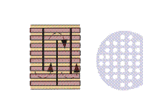
Heat exchanger INTERIOR DESIGN
Baffle types
Baffles are installed on the shell side to give a higher heat-transfer rate due to increased turbulence and to support the tubes thus reducing the chance of damage due to vibration.
Single segmental (this is the most common)
Baffles specification:
Number of baffles = 5
Baffle spacing(20 % of shell diameter) = 288.25 mm
Notes:
To maximize heat exchange, we use *baffles* with a *25% cut. This forces the fluid into a turbulent, zigzag **cross-flow* pattern around the tubes, which greatly enhances the heat transfer rate.

Slide 51
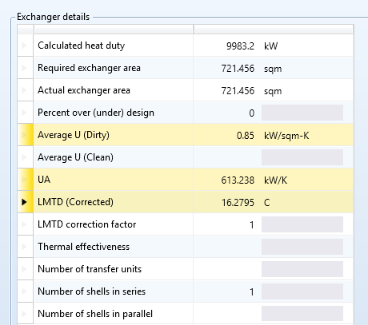
Exchanger details:
Calculated:
Heat exchanger area = 735.3 m²
UA value = 625 kW/K
Aspen Results:
Heat exchanger area = 721.45 m²
UA value = 613.24 kW/K
The above calculated data matches with results obtained from Aspen:
Notes:
Key Technical Result (Re):* The most important result is the calculated *Reynolds number* for the shell-side flow: *32,004.6. Since this is well above 10,000, we confirm **highly turbulent flow* is achieved.

Slide 52
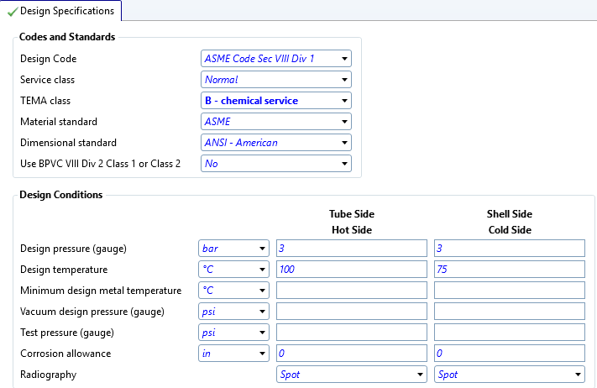
Exchanger Design specifications (EDR) :

Slide 53
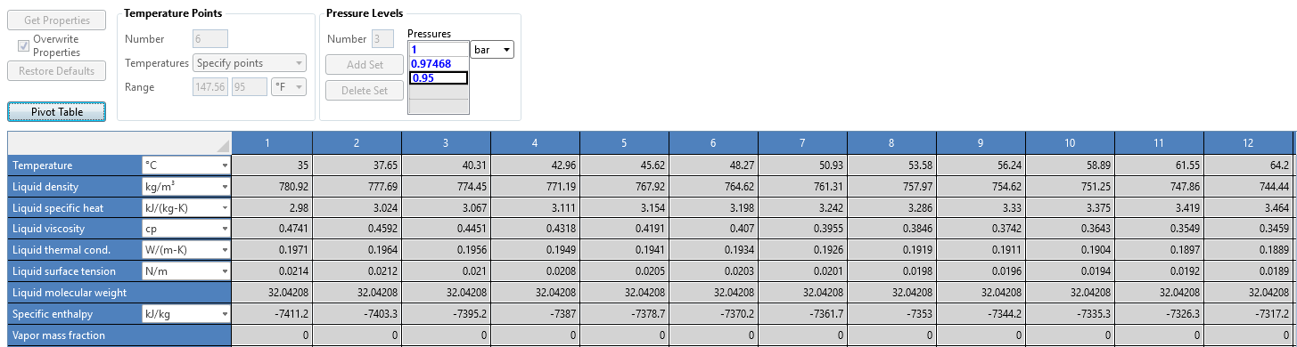
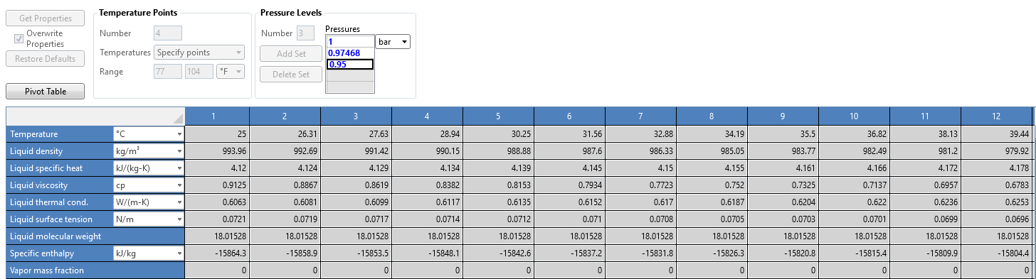
Exchanger Design and Rating (EDR) :
EDR is a feature in Aspen used for the thermal and mechanical design and analysis of heat exchangers.
Tube results (All the properties of hot fluid, methanol):
Shell results (All the properties of cold fluid, water):
Notes:
We can see the results of hot and cold fluid in tube and shell side and we can also see the value of temerature dependent properties

Slide 54
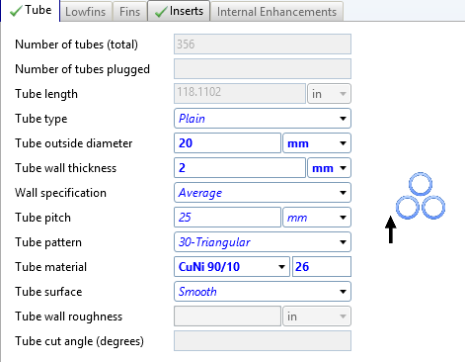
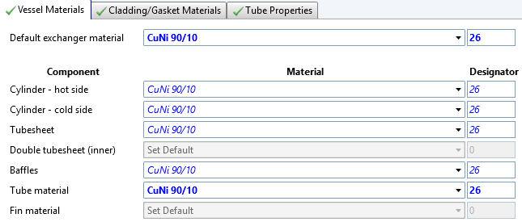
Tube material used:
Notes:
Corrosion Resistance, Corrosion Resistance, he addition of 10% Nickel improves the mechanical strength

Slide 55
PINCH TECHNOLOGY

Slide 56
PINCH TECHNOLOGY
Distillation Column Sequencing:
Methanol + Water
Methanol
Methyl Benzoate
Benzoic Acid
Stream | Condition | Flowrate (kg/s) | mCp (kW/C) | Tin | Tout | Qav (Kw)
1 (D2) | Hot | 106.15 | 341.89 | 64 | 35 | 9914.81
2 (D3) | Hot | 2.72 | 4.67 | 191 | 35 | 728.21
3 (D4) | Hot | 0.95 | 1.73 | 248 | 35 | 369.09
4 (LIQOUT) | Cold | 110.20 | 374.54 | 50 | 54 | 1498.16
5 (MIXOUT) | Cold | 110.20 | 348.69 | 25 | 50 | 8717.15
C1
C2
C3
C4
Methyl Benzoate + Benzoic Acid + Phthalic Acid
Water
Benzoic Acid + Phthalic Acid
Phthalic Acid

Slide 57
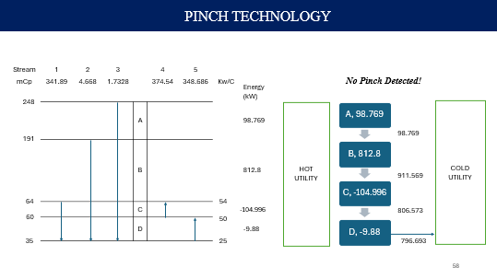
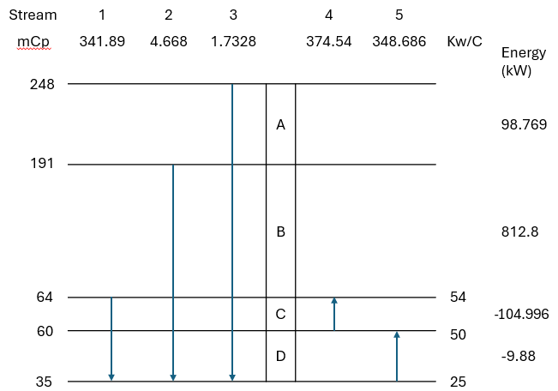
PINCH TECHNOLOGY
Stream | Condition | Flowrate (kg/s) | mCp (kW/C) | Tin | Tout | Qav (Kw)
1 (D2) | Hot | 106.15 | 341.89 | 64 | 35 | 9914.81
2 (D3) | Hot | 2.72 | 4.67 | 191 | 35 | 728.21
3 (D4) | Hot | 0.95 | 1.73 | 248 | 35 | 369.09
4 (LIQOUT) | Cold | 110.20 | 374.54 | 50 | 54 | 1498.16
5 (MIXOUT) | Cold | 110.20 | 348.69 | 25 | 50 | 8717.15
Minimum number of Heat Exchangers = 5
1
9914.81
2
728.208
3
369.0864
8717.15
1197.66
300.5
427.708
369.0864
5
8717.15
4
1498.16
CU
796.776

Slide 58
PINCH TECHNOLOGY
Stream | 1 | 2 | 3 |  | 4 | 5
mCp | 341.89 | 4.668 | 1.7328 |  | 374.54 | 348.686 | Kw/C | Energy (kW)
 |  |  |  | A |  |  |  | 98.769
 |  |  |  | B |  |  |  | 812.8
 |  |  |  | C |  |  |  | -104.996
 |  |  |  | D |  |  |  | -9.88
No Pinch Detected!
248
COLD UTILITY
HOT
UTILITY
A, 98.769
191
98.769
B, 812.8
911.569
C, -104.996
64
54
806.573
60
50
D, -9.88
35
25
796.693

Slide 59
PINCH TECHNOLOGY
1
2
3
64
191
248
4
50
HEN 1
53.2
HEN 3
54
54
Process Streams
Heat Exchangers
60.496
126.81
248
Qc
Cooling Utility
25
50
50
Connection directions
5
HEN 2
50
35
126.81
248
Qc
HEN 4
HEN 5
35
35
35

Slide 60
PINCH TECHNOLOGY

Slide 61
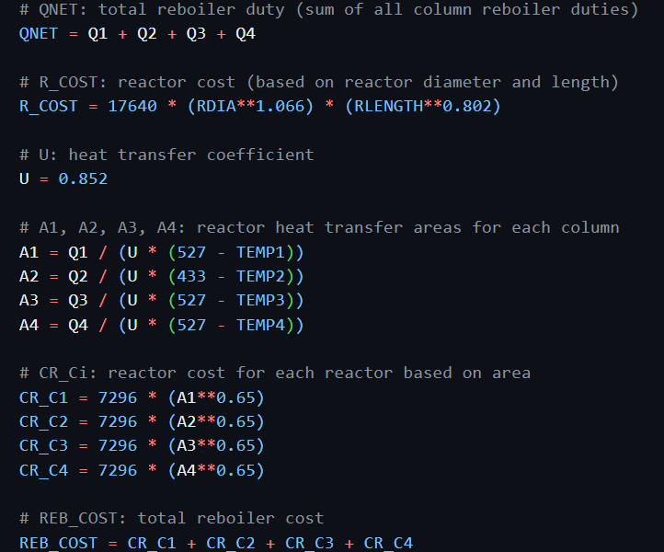
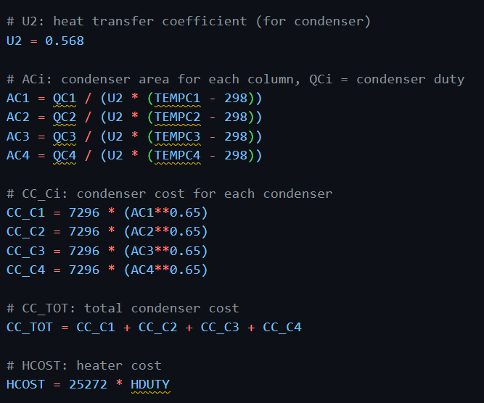
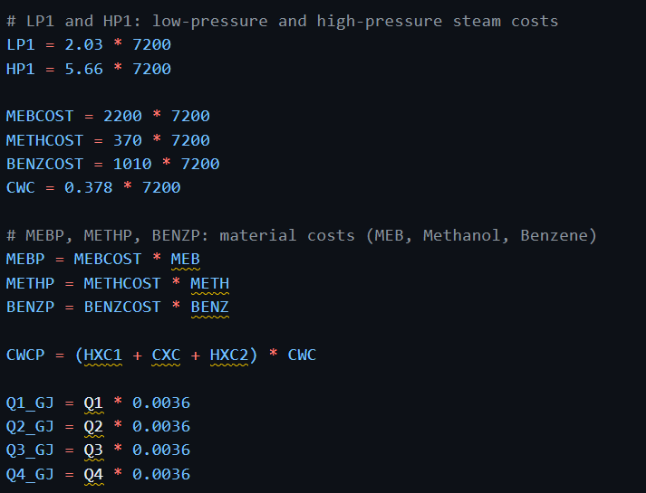
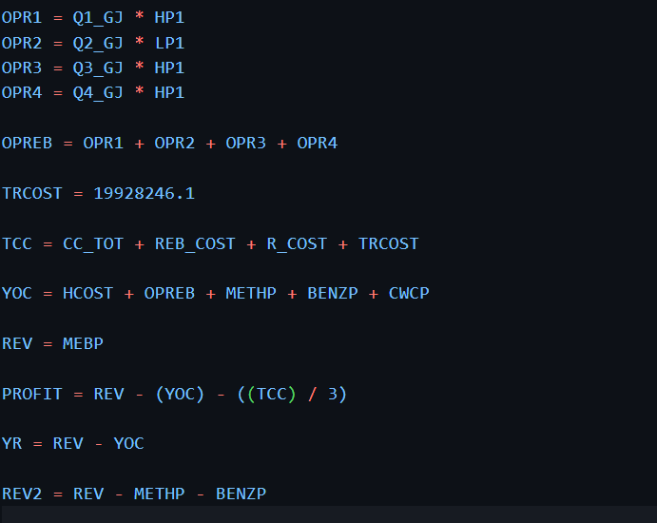
Techno-economic Analysis
We performed the sensitivity analysis to optimize the profit of our plant, in which we have included the below cost.
Reboiler Cost
Condenser Cost
Heater Cost
Tray Cost
Reactor Cost
Feed and Product Cost

Slide 62
Techno-economic Analysis
We performed the sensitivity analysis to optimize the profit of our plant, in which we have included the below cost.
Reboiler Cost
Condenser Cost
Heater Cost
Tray Cost
Reactor Cost
Feed and Product Cost

Slide 63
Techno-economic Analysis
We performed the sensitivity analysis to optimize the profit of our plant, in which we have included the below cost.
Reboiler Cost
Condenser Cost
Heater Cost
Tray Cost
Reactor Cost
Feed and Product Cost

Slide 64
Techno-economic Analysis
We performed the sensitivity analysis to optimize the profit of our plant, in which we have included the below cost.
Reboiler Cost
Condenser Cost
Heater Cost
Tray Cost
Reactor Cost
Feed and Product Cost

Slide 65
Techno-economic Analysis
We performed the sensitivity analysis to optimize the profit of our plant, in which we have included the below cost.
Reboiler Cost
Condenser Cost
Heater Cost
Tray Cost
Reactor Cost
Feed and Product Cost

Slide 66
Techno-economic Analysis
We performed the sensitivity analysis to optimize the profit of our plant, in which we have included the below cost.
Reboiler Cost
Condenser Cost
Heater Cost
Tray Cost
Reactor Cost
Feed and Product Cost

Slide 67
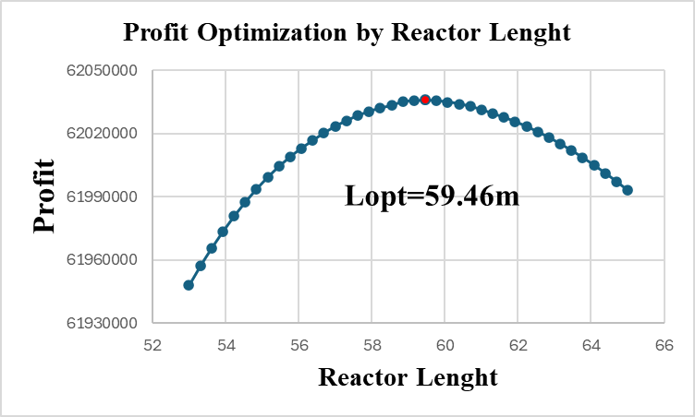
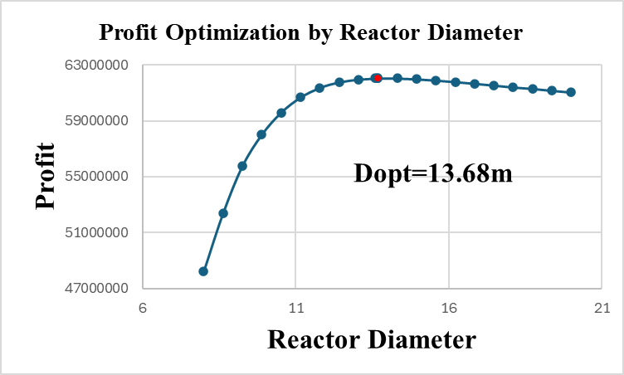
Techno-economic Analysis
Notes:
Reactor cost v/s conversion tradeoff

Slide 68
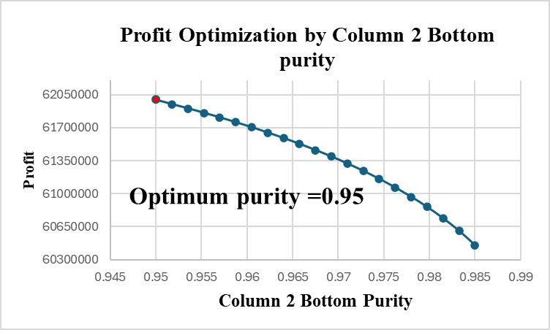
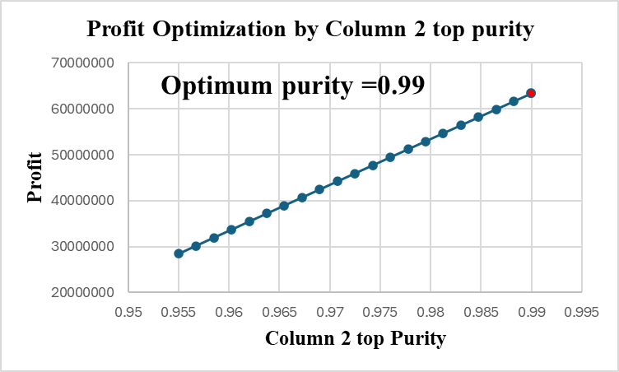
Techno-economic Analysis
Notes:
Methanol recovery increases fresh req reduces hence cost
Water recovery increases causing higher reboiler duty

Slide 69
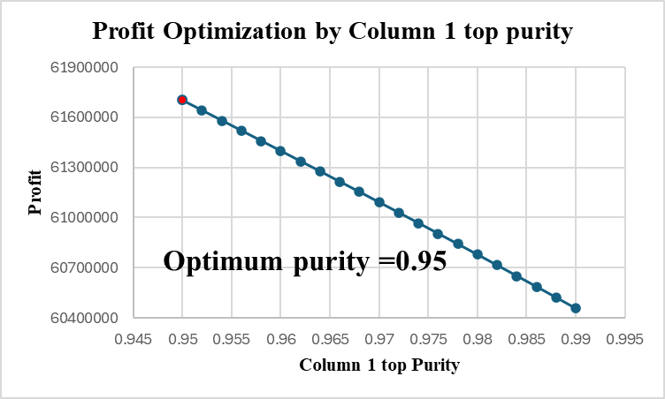
Techno-economic Analysis
RESULTS (UNITS) | VALUES
TOTAL CAPITAL COST (TCC) ($) | 2.98 x 10⁷
YEARLY OPERATING COST (YOC) ($) | 1.39 x 10⁸
INPUT COST (RAW MATERIALS COST) ($) | 1.06 x 10⁸
REVENUE (PRODUCT MARKET PRICE) ($) | 2.14 x 10⁸
PAYBACK PERIOD (PBP) (YEARS) | 3
TOTAL ANNUALISED COST (TAC) ($) | 1.49 x 10⁸
TOTAL ANNUAL PROFIT (TAP) ($) | 6.46 x 10⁷
Notes:
Enriching this stream cause higher reboiler duty

Slide 70
Thanks!
Presented by Group 4:
Aaditya Amlan Panda (220007)
Abhijit Dalai (220030)
Adarsh Pal (220054)
Akash Kumar Gupta (220095)
Kushagra Tiwari (220574)
Saurabh Yadav (220991)
Snehil Tripathi (221071)
Tushar Verma (221147)

